Slide 1
Fiscal Compliance

Slide 2
Objectives
To cover fiscal compliance and internal control issues commonly noted in internal audits.
Independent verification of transactions (cash receipts, P-Card transactions, and fuel card purchases).
Justification for departmental sales account balance carryovers.
Appropriate use of “various” accounts.
Timely reconciliation and return of “special purpose” petty cash accounts.
Monitoring general purpose petty cash and change funds
Justification and use of course/lab fees.
Personnel Activity Reports (PAR forms) and delayed cost sharing.
Monitoring origins of timestamps in Kronos.

Slide 3
Independent Verification of Transactions
Cash Receipts:
No receipt form or check log (lack of audit trail).
No independent verification that all funds collected were deposited.
Person responsible for billing customers and recording the accounts receivable balance also has access to collections.

Slide 4
Independent Verification of Transactions
P-Cards and Other Purchases:
Examples:
Ink cartridges costing more than the printer
Unreasonable number of cartridges purchased
Unapproved cell phone service
Computer parts
Failure to verify unfamiliar vendors

Slide 5
Independent Verification of Transactions
Vehicles:
Gas Card
Controlling access to cards.
Not matching receipts with charges – Andre Simmons (2-2786).
Not reviewing miles-per-gallon use.
Controlling access to keys.

Slide 6
Independent Verification of Transactions

Slide 7
Justification for Departmental Sales Account Deferred Revenue
Deferred revenue is unearned income - funds collected for future service or products.
Request letter sent to Accounting
Retain support for the requested deferred amount.
Needed for departmental records and audit inquiries
Notes:
Focus is on the need for departments to retain the supporting documentation as the letter explains.

Slide 9
Justification for Departmental Sales Account Carry Forward
Excess Earned Income – Income realized less actual incurred expenses
Incurred expenses include items ordered but not yet received or billed.
Submit carry forward request
Need to justify/explain use of carry forward funds
Retain support for departmental records and audit inquiry
Notes:
Determining whether institutions are complying with legal and reporting requirements with respect to carry-forward funds is one of nine areas the BOR Internal Audit Office identified in 2011 as an area of potential risk. In light of decreased state budgets, there is increased awareness of carry forward mechanisms and BOR auditors are paying closer attention to carry forward and whether it is properly handled and documented. UGA has a good set of documentation standards for carry forward of departmental sales and it results in the ability for the University to justify carry forward when questions are asked. Departments should maintain the support that was used in completing the carry forward request documentation so that in the event of questions, departments can explain how they arrived at the justification.

Slide 10
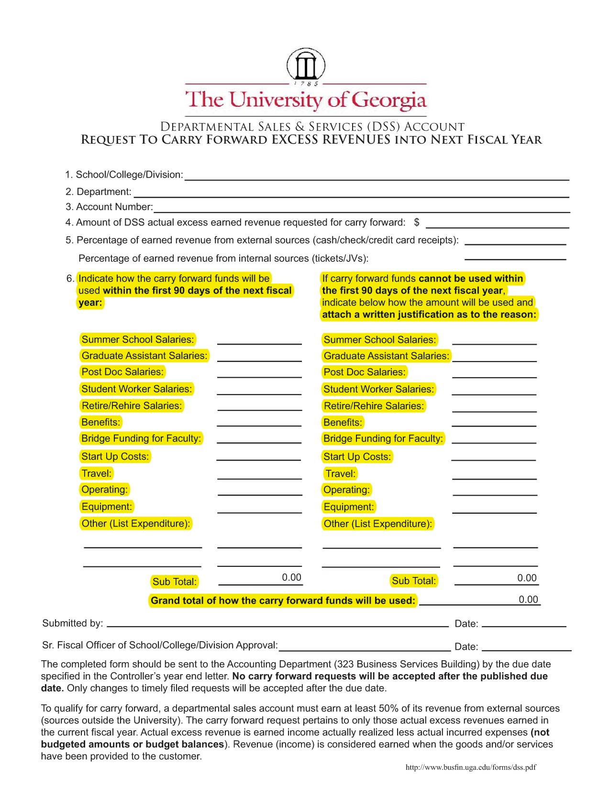

Slide 11
Various Accounts
Various Account is a discretionary restricted account used for gift receipts
Depositing revenue into a various account.
Instructing customers to describe payments as unrestricted gifts.
Transferring un-used grant and contract balances into a various account.

Slide 12
Various Accounts

Slide 13
Various Accounts

Slide 14
Study Abroad Petty Cash Balances
Un-resolved for a long period of time.
Perform monthly reconciliations of petty cash bank accounts using internal records of transactions.
Prepare an accurate fund composition reconciliation on a monthly basis.

Slide 15
Petty Cash and Change Fund Accounts
Underutilized
Petty Cash Advances
Document
Track
Close when staff /faculty change.
Timely Independent Verification
Test Counts
Independent review of petty cash checking accounts
Outstanding (un-cleared) checks
Cannot just cancel the check
Funds need to be reverted to the state
Controls for participant gift cards

Slide 16
Class Fees/Course & Lab Fees
Justified for a specific purpose
Consumable materials and supplies
Approved
Used as intended
Reconcile class enrollment to fees collected

Slide 17
Sponsored Research
Personnel Activity Reports (PAR Forms)
Late approval seems to be corrected.
However, late correcting entries indicate that the reports are not accurate.
Delayed Cost Sharing

Slide 18
Kronos
Students logging in/out from remote locations.
Forgetting to log out.
Need to review Kronos Punch Origin Reports.

Slide 19
Kronos

Slide 20
User Access to Financial Systems
Increased review of financial systems by state auditors
Authorized user access
Review of authorized users and their permissions
Access removal when employee leaves or moves to another department
Notes:
In addition to performing an annual financial audit, state auditors perform specific tests on controls of the various financial systems UGA uses to process transactions which could impact the information provided in UGA financial statements. This includes a review of the core financial system but also peripheral systems such as Kronos for timekeeping, the leave system, UGAMart, eCheck Request/eTravel, the work order system used by PPD, and others. There are a number of tests conducted to determine if users with access to these various systems have the appropriate access and if users who leave the University or leave a department or even change duties within a department continue to have the appropriate access. Auditors look to see what practices are in place that monitor user and logical access. Departments will begin to see reminder notices from the Controller’s Division asking for review of persons with access to determine what changes are needed.

